Slide 1
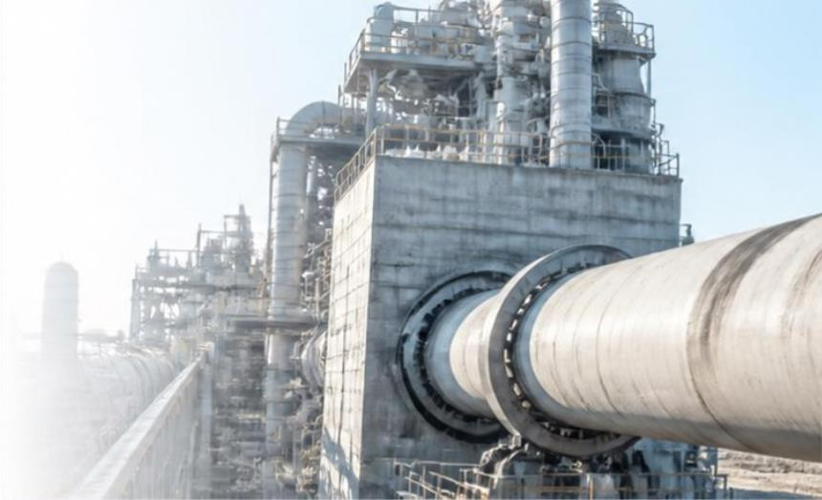
Cyclone Preheater Abnormality Detection
Problem Statement
Identify time periods where the cyclone preheater exhibits abnormal operating behaviour from historical sensor data.
Objective: - Identify time periods where the cyclone preheater operates differently from its normal process behaviour using historical sensor data.
Dataset:-
377,719 observations collected from the cyclone preheater
6 process sensors measuring temperature and draft
Data recorded at 5-minute intervals
Covers approximately 3.5 years of operation
Period: January 2017 – August 2020

Slide 2
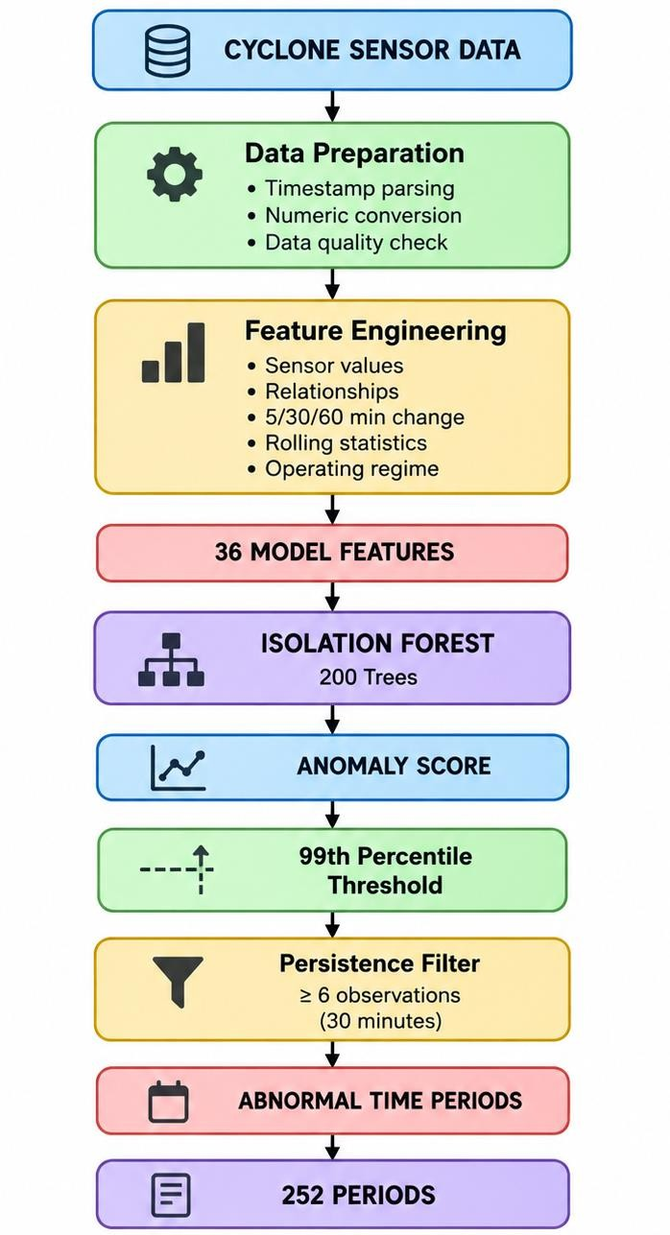
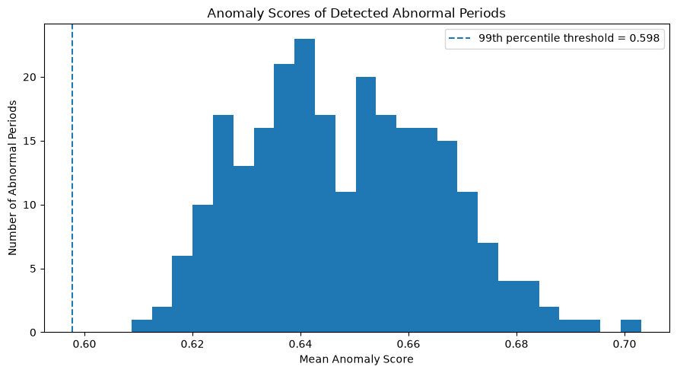
Data Preparation & Feature Engineering & flow
Data Preparation
Converted the recorded timestamps into a consistent datetime format.
Sorted the data chronologically and checked the time intervals.
Converted sensor readings into numeric values.
Kept system/status values separate from the sensor measurements.
Checked missing values and duplicate timestamps before modelling.
Feature Engineering
Model Features:
36 features were selected for anomaly
detection after feature creation.
The features capture the process state, relationships, changes, variability and operating regime..
Feature Group | Features Created
Relationships | Temperature & draft relationships
Changes | 5, 30 & 60-minute changes
Rolling Statistics | 60-minute rolling mean & standard deviation
Operating Regime | Temperature-based process regime

Slide 3
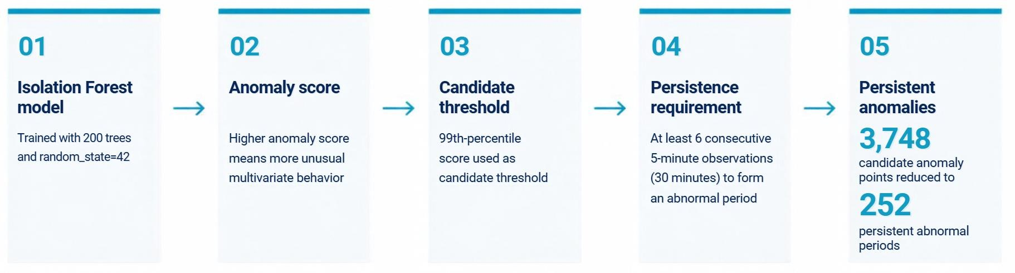
Isolation Forest - Anomaly Detection Why this method?
Methodology
No labelled abnormal events were available.
Isolation Forest is an unsupervised anomaly-detection algorithm.
It can identify unusual combinations of multiple process variables.
How It Works
Isolation Forest randomly splits the feature space. Unusual observations are easier to isolate and therefore require fewer splits than normal observations.

Slide 4
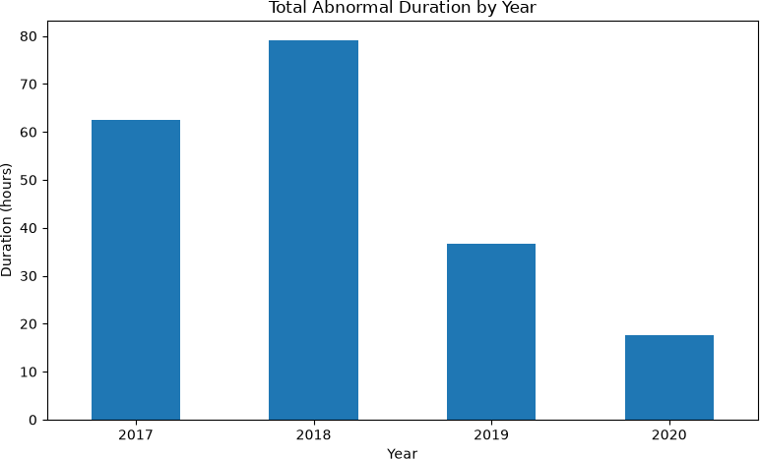
Anomaly Detection and Key Findings
Abnormal Period Detection Results
Detection Results:-
3,748 observations identified above the
anomaly threshold
252 sustained abnormal periods identified
Minimum persistence: 6 consecutive observations (30 minutes)
Total detected abnormal duration: 8 days 3 hours 55 minutes.
Year-wise Distribution
Key Findings
Abnormal periods were detected throughout the dataset.
2018 recorded the highest number of abnormal periods.
The strongest detected anomaly had a score of 0.7406.
Detected periods represent unusual operating behaviour, not confirmed equipment failure.
Year | Abnormal Periods | Total Duration
2017 | 80 | 2d 14h 30m
2018 | 102 | 3d 7h 10m
2019 | 49 | 1d 12h 35m
2020 | 21 | 17h 40m

Slide 5
Representative Conclusion of Abnormal Period
Strongest Detected Abnormal Period:
27 November 2018 | 05:40 - 06:30
Duration: 50 minutes
Mean Anomaly Score: 0.7030 Maximum Anomaly Score: 0.7406
Process Behaviour During the Period
Inlet Gas Temperature ↓
Gas Outlet Temperature ↓
Material Temperature ↓
Outlet Gas Draft → near-zero / positive
Cone Draft → near-zero
Inlet Draft → near-zero / positive
Observed Process Changes
Inlet Gas Temperature - 911.28 → 750.47
Gas Outlet Temperature - 866.23 → 716.14
Material Temperature - 951.90 → 547.53
Outlet Gas Draft - -252.02 → 19.52
Cone Draft - -252.01 → -4.23
Inlet Draft - -193.86 → 16.99
Values shown as 1 hour before → abnormal
period average.

